Slide 1
Exceptions

Slide 2
Throwing an Exception
public class SSN {
private String SSNumber;
public SSN (String s) {
if (isValidSSN(s) )
SSNumber = s;
else
throw new IllegalSSNException("Invalid SSN: "+s);
}
...

Slide 3
Defining a new Exception
public class SSN {
private String SSNumber;
public SSN (String s) {
if (isValidSSN(s) )
SSNumber = s;
else
throw new IllegalSSNException("Invalid SSN: "+s);
}
...
This exception is not in the Java class library.

Slide 4
Extend an Existing Exception
public class IllegalSSNException
extends IllegalArgumentException {
public IllegalSSNException(String message) {
super (message);
}
}

Slide 5
Exception Hierarchy
Java.lang.Object
Throwable
Error
Exception
IOException
RuntimeException
IllegalArgumentException
IndexOutOfBoundsException
IllegalSSNException
NullPointerException

Slide 6
What Happens When an Exception is Thrown?
The Runtime System looks for a method that can handle the exception
If no such method is found, the Runtime System handles the exception and terminates the program
The Runtime System looks at the most recently called method, and backs up all the way to the main program

Slide 7
Main
A();
A:
B();
B:
C();
C:
Main program starts
Main
Runtime Stack

Slide 8
Main
A();
A:
B();
B:
C();
C:
Main program calls A
A
Main
Runtime Stack

Slide 9
Main
A();
A:
B();
B:
C();
C:
A calls B
B
A
Main
Runtime Stack

Slide 10
Main
A();
A:
B();
B:
C();
C:
B calls C
C
B
A
Main
Runtime Stack

Slide 11
Main
A();
A:
B();
B:
C();
C:
exception!
C causes an exception
C
B
A
Main
Runtime Stack

Slide 12
Main
A();
A:
B();
B:
C();
C:
exception!
C cannot handle the exception
The JVM terminates C, removes it from the
stack, and throws the exception to B
JVM
C
B
A
Main
Runtime Stack

Slide 13
Main
A();
A:
B();
B:
C();
C:
exception!
JVM
B cannot handle the exception
The JVM terminates B, removes it from the
stack, and throws the exception to A
A
Main
Runtime Stack

Slide 14
Main
A();
A:
B();
B:
C();
C:
exception!
JVM
A cannot handle the exception
The JVM terminates A, removes it from the
stack, and throws the exception to Main
Main
Runtime Stack

Slide 15
Main
A();
A:
B();
B:
C();
C:
exception!
JVM
Main cannot handle the exception
The JVM terminates Main, removes it from the
stack, and prints a stack trace to the console
Runtime Stack

Slide 16
Main
A();
A:
B();
B:
C();
C:
exception!
A, B and C are all exception propagators because by not handling the exception, they pass it back to the calling program.
If one of these methods knew how to handle the exception, it would be an exception catcher

Slide 17
The try/catch block
try {
catch (Exception e) {
}
some statements here which may throw an exception
some statements to be executed if an Exception happens
the program then continues...

Slide 18
Example
while (true) {
try {
num = JOptionPane.showInputDialog
null, "Enter a number");
n = Integer.parseInt(num);
JOptionPane.showMessageDialog
(null,"Thank you for entering "+n);
if(n==0)System.exit(0);
}
catch (Exception e) {
JOptionPane.showMessageDialog
(null,"That is not a number! Try again");
}
}

Slide 19
while (true) {
try {
num = JOptionPane.showInputDialog
null, "Enter a number");
n = Integer.parseInt(num);
JOptionPane.showMessageDialog
(null,"Thank you for entering "+n);
if(n==0)System.exit(0);
}
catch (Exception e) {
JOptionPane.showMessageDialog
(null,"That is not a number! Try again");
}
}
This is very general... any exception that happens
will be caught here.
What kind of exception does parseInt throw?

Slide 20
parseInt
public static int parseInt(String s) throws NumberFormatException
while (true) {
try {
num = JOptionPane.showInputDialog
null, "Enter a number");
n = Integer.parseInt(num);
JOptionPane.showMessageDialog
(null,"Thank you for entering "+n);
if(n==0)System.exit(0);
}
catch (NumberFormatException e) {
JOptionPane.showMessageDialog
(null,"That is not a number! Try again");
}
}

Slide 21
What if multiple exceptions can be thrown in the try block?
try {
n = Integer.parseInt(num);
a[i] = n;
}
catch (NumberFormatException nfe) {
JOptionPane.showMessageDialog(null,“Not a number!“或者可以写[nfe.getMessage()]);
}
catch (IndexOutOfBoundsException ioob) {
System.out.println("Bad array index: "+i);
}
catch (Exception e) {
System.out.println("An exception occurred.");
}
The JVM will go through the catch blocks top to bottom until a matching exception is found

Slide 22
What if multiple exceptions can be thrown in the try block?
try {
n = Integer.parseInt(num);
a[i] = n;
}
catch (Exception e) {
System.out.println("An exception occurred.");
}
catch (NumberFormatException nfe) {
JOptionPane.showMessageDialog(null,"Not a number!");
}
catch (IndexOutOfBoundsException ioob) {
System.out.println("Bad array index: "+i);
}
This is why the order of the exceptions listed is important.. because of the class hierarchy and inheritance, a NumberFormatException is an Exception, and the first catch block will handle it.

Slide 23
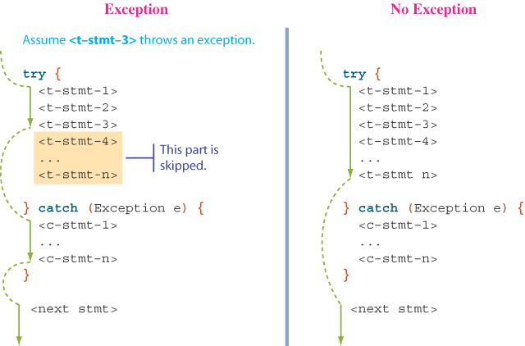
Try/Catch Flow

Slide 24
Example from the SSN class
ssnRead = inFile.readLine();
while (ssnRead != null) {
try {
mySSN = new SSN(ssnRead);
mySubscripts.append(Integer.toString(subscript++)+"\n");
myTextArea.append(mySSN+"\n");
ssnRead = inFile.readLine();
}
catch (IllegalSSNException issne) {
System.out.println(issne.getMessage());
}
}
There is an error here!
If an exception occurs, the next line from the file is not read. This needs to be whether or not there is an exception.

Slide 25
The finally block is executed whether or not an exception occurs.
ssnRead = inFile.readLine();
while (ssnRead != null) {
try {
mySSN = new SSN(ssnRead);
mySubscripts.append(Integer.toString(subscript++)+"\n");
myTextArea.append(mySSN+"\n");
}
catch (IllegalSSNException issne) {
System.out.println(issne.getMessage());
}
finally {
ssnRead = inFile.readLine();
}（finally code will always be done)
}
finally executes even if there is a return statement prior to the final code.

Slide 26
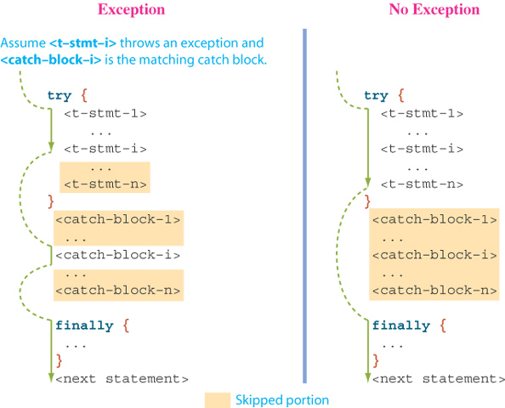
Try/catch/finally flow

Slide 27
Checked and Unchecked Exceptions
Excluding exceptions in the class RuntimeException, the compiler must find a catcher or a propagator for every exception.
RuntimeException is an unchecked exception.
All other exceptions are checked exceptions.

Slide 28
class A {
public A () throws NumberFormatException {}
}
class B {
public void C () {
A xyz = new A();
}
}
This is OK; the exception will be propagated.
class B {
try {
A xyz = new A();
}
catch {NumberFormatException nfe {
}
This is OK; the exception will be caught.

Slide 29
class A {
public A () throws IOException {}
}
class B {
public void C () throws IOException {
A xyz = new A();
}
}
This is OK; the exception will be propagated.
class B {
try {
A xyz = new A();
}
catch {IOException nfe {
}
This is OK; the exception will be caught.

